Slide 1
NeRF: Representing Scenes as Neural Radiance Fields for View Synthesis
Ben Mildenhall, Pratul P. Srinivasan, Matthew Tancik, Jonathan T. Barron, Ravi Ramamoorthi, Ren Ng
2020

Slide 2
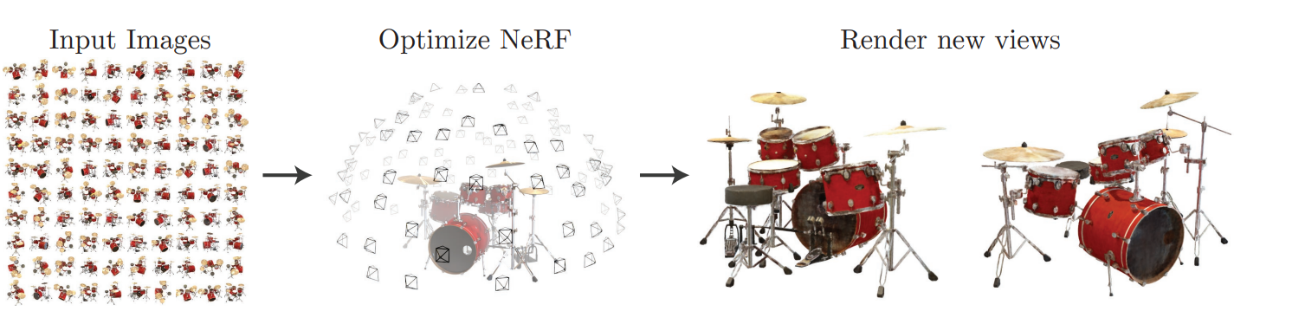
Goal : Represent novel views of complex scenes
Fig. 1: A method that optimizes a continuous 5D neural radiance field representation (volume density and view-dependent color at any continuous location) of a scene from a set of input images.

Slide 3


Slide 4
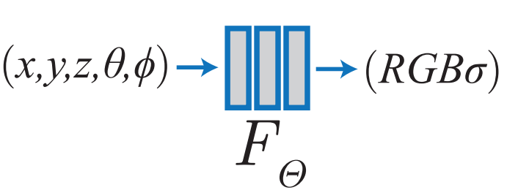
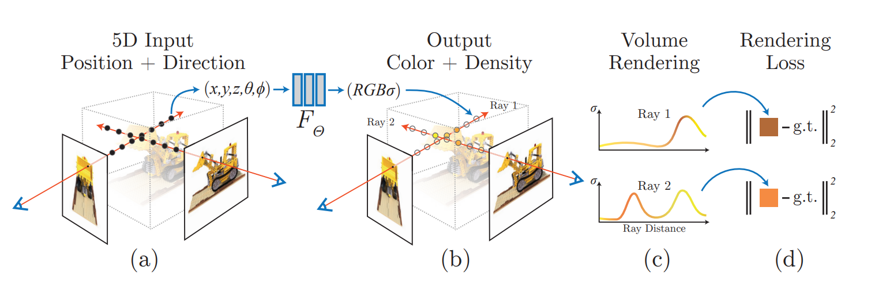
How to do it?
KEY IDEA: Overfit the network to the image.
So the scene is represented in the weights of the model.

Slide 5
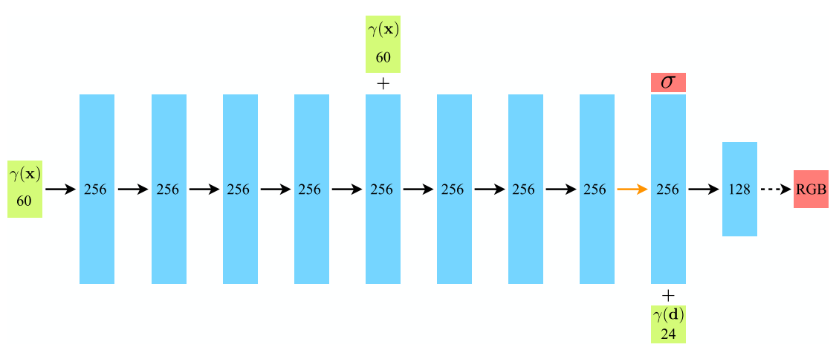
How to do it?
KEY IDEA: Overfit the network to the image.
So the scene is represented in the weights of the model.

Slide 6
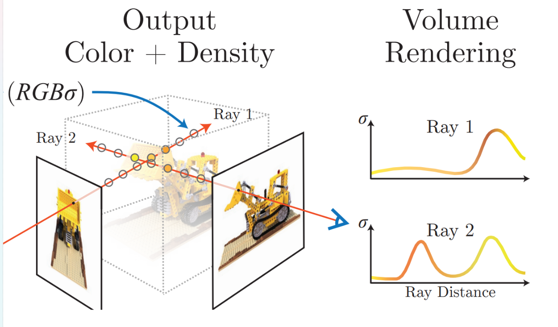
Notes:
Traditional volume rendering
Aca hablamos de lo entra y sale, de los rays, tal vez usamos la grafica esa de como evoluciona el ray en
Captura transparencia

Slide 7
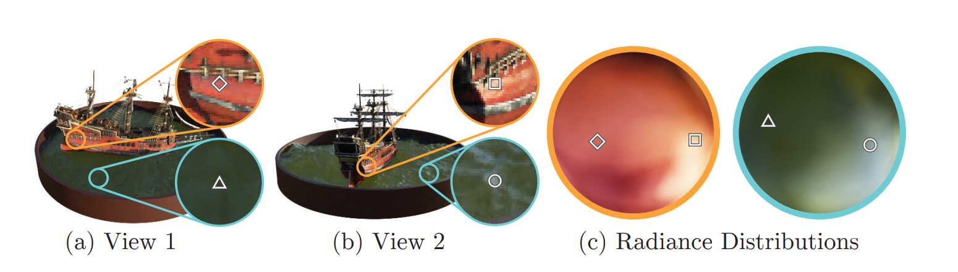
How color changes from different viewing directions
Fig. 2: A visualization of view-dependent emitted radiance. The neural radiance field representation outputs RGB color as a 5D function of both spatial position x and viewing direction d.

Slide 8

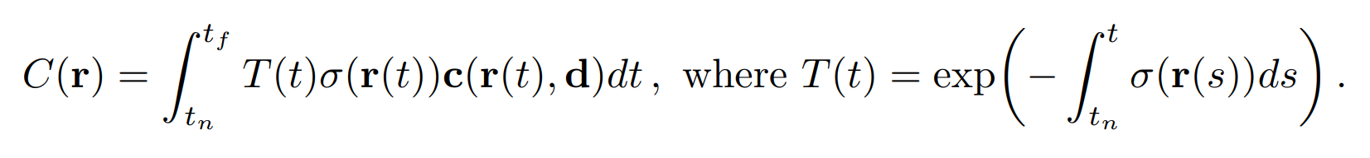
Density at the point. Tells you if there is “something”.
Color of that point from a specific viewing direction d.
Accumulated transmittance: how much light has been blocked in point t.
Where : r is the ray; tf and tn are the near and far bound, and d is the viewing direction (θ, φ)
Notes:
tn and tf are the near and far bound that determine the range of distances from the camera that should be included in the rendered scene.

Slide 9
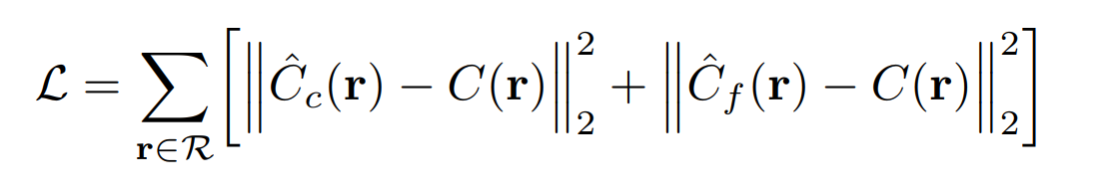
L2 - Loss

Slide 10
However, they implement 2 tricks
Positional Encoding
Hierarchical Volume Sampling

Slide 11
Hierarchical Volume Sampling
Densely evaluating the neural radiance field network at N query points along each camera ray is inefficient.
Free space and occluded regions that do not contribute to the rendered image are still sampled repeatedly
Instead, hierarchical representation that increases rendering efficiency by allocating samples proportionally to their expected effect on the final rendering.
What does it mean?

Slide 12
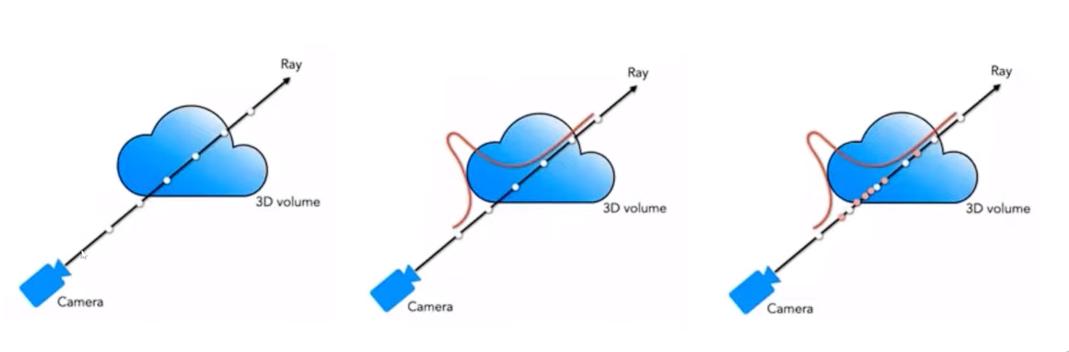
Optimize at the same time 2 networks
The coarse is first calculated.
Given the output, it is possible to produce a more informed sampling of points along each ray where important details are.
A second set of sample Nf locations is taken from this distribution.
Notes:
- evaluate our “fine” network at the union of the first and second set of samples,
and compute the final rendered color of the ray Cˆ f (r) using Eqn. 3 but using all Nc+Nf samples.

Slide 13
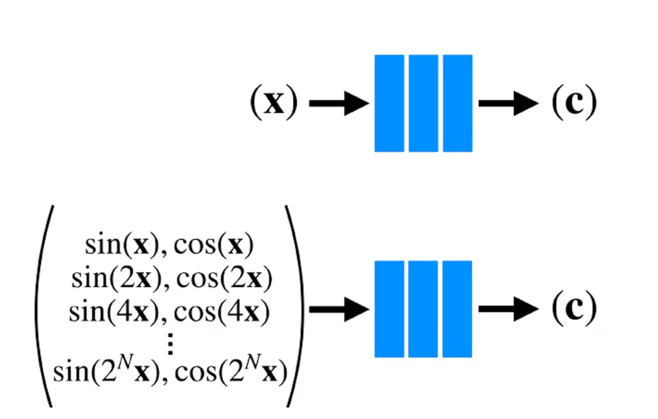
Positional Encoding :
Deep networks are biased towards learning lower frequency functions.
Results in renderings that perform poorly at representing high-frequency variation in color and geometry.
Transformers use a similar mapping. However, they use it for a different goal.
In contrast, NERF uses these functions to more easily approximate a higher frequency function.
Notes:
deep networks are biased towards learning lower frequency functions.
these functions to map continuous input coordinates into a higher dimensional space to enable our MLP to more easily approximate a higher frequency function.

Slide 14
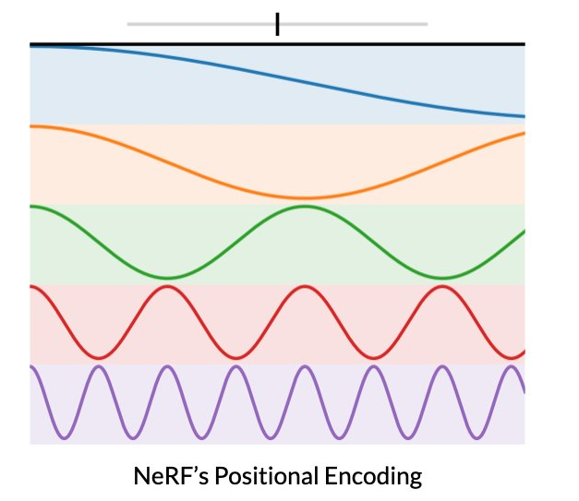
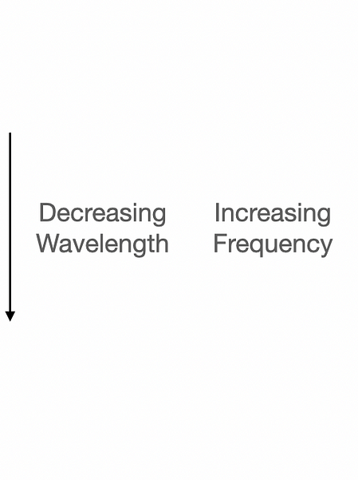
Notes:
Finer details as frequency increases.
enables better fitting of data that contains high frequency variation

Slide 15
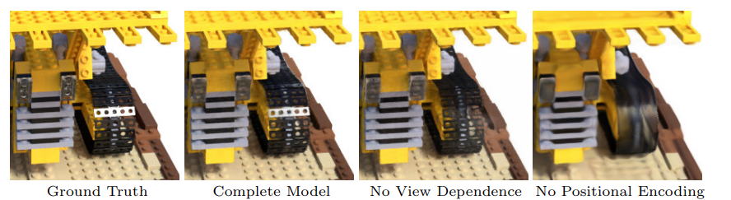
Fails to represent high frequency geometry and texture.
No specular reflection on the bulldozer tread.
Fig. 3: Visualization of how the model benefits from representing view dependent emitted radiance and from passing the input coordinates through a high-frequency positional encoding.

Slide 16
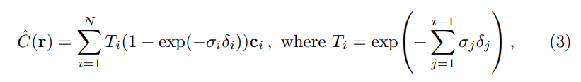
to estimate C(r) with the quadrature rule

Slide 17
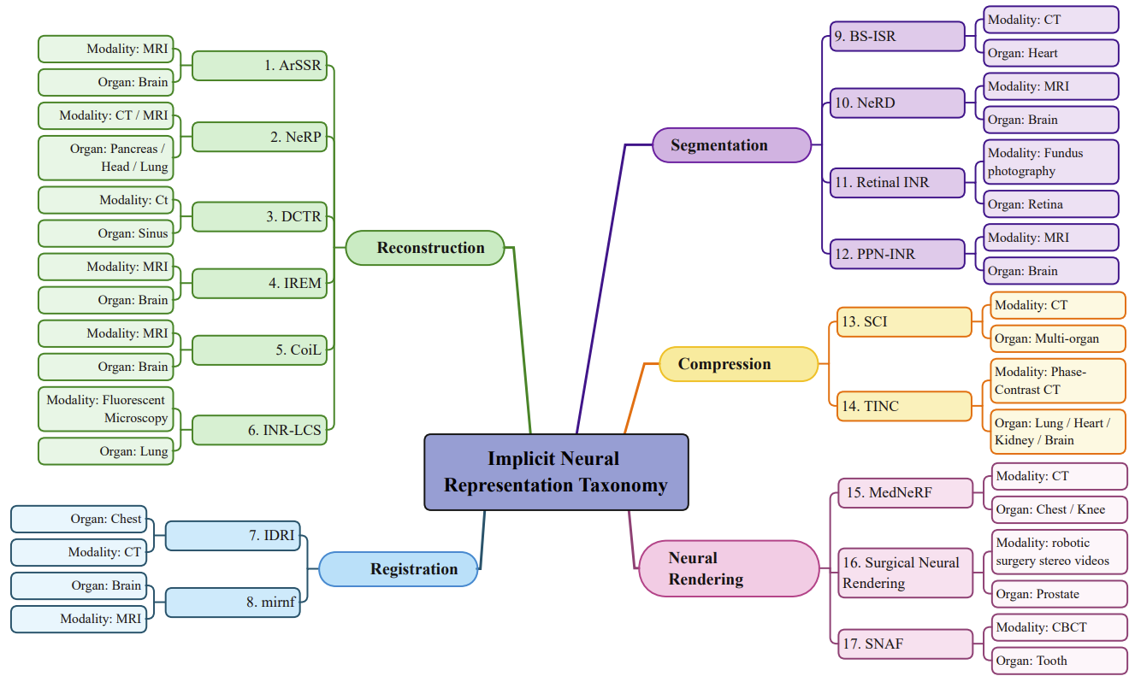
Implicit Neural Representation in Medical Imaging:
A Comparative Survey
Molaei, A., Aminimehr, A., Tavakoli, A., Kazerouni, A., Azad, B., Azad, R., & Merhof, D. (2023, July 30).
The article aims to “provide a comprehensive overview of INR models in the field of medical imaging”.

Slide 18
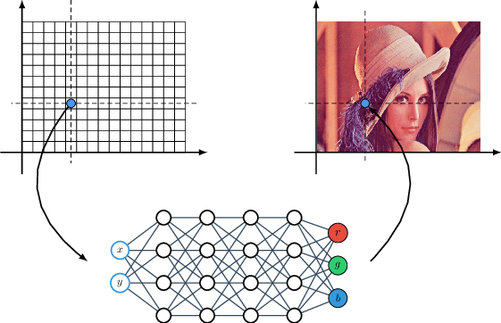
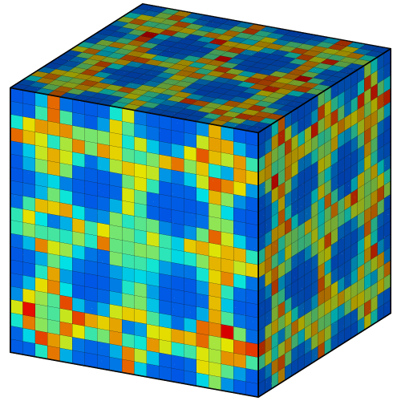
Visual world
Explicit representation
Implicit representation
MLP’s

Slide 19
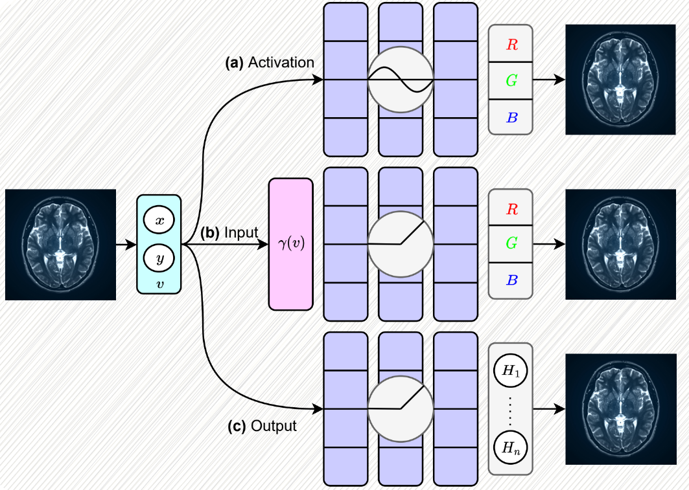
MLP’s Advantages
Disadvantage
They operate in the continuous domain
The memory requirements for representing the signal are not limited by its resolution (interest within the medical community)
MLP models are differentiable
MLPs assist INRs in mitigating potential locality biases that could hinder performance
They can fail to encode high-frequency details
Fig. “The figure illustrates various modifications to alleviate the spectral bias problem in INRs”

Slide 20
Clinical Importance
Reconstruction: CNNs vs INRs
Collection of ground truth annotated data is a huge challenge in automated medical imaging
INRs can be resolution-agnostic
INRs can solve inverse imaging problems
INRs can enhance perception and understanding of a surgical environment
NeRP
DCTR
IREM
ArSSR
INR-LCS
CoiL

Slide 21
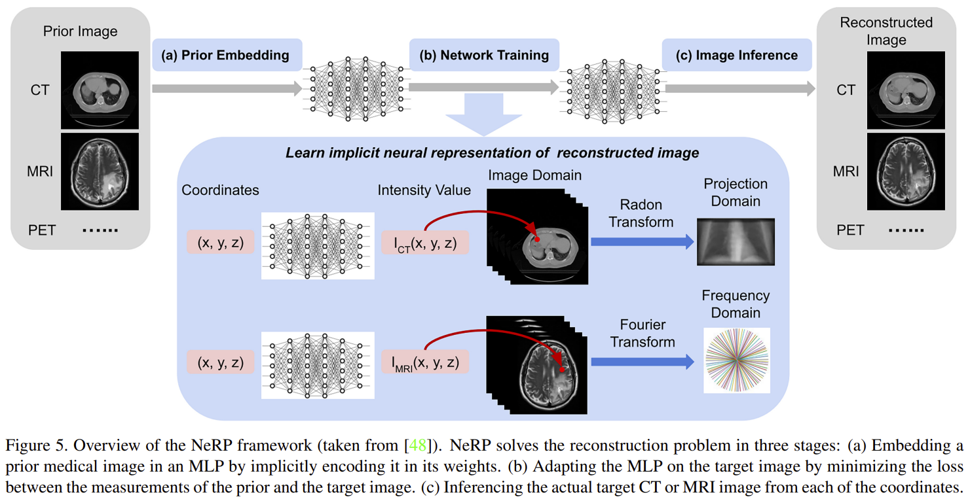

Slide 22
